Slide 1
Getting limited goods
what users want and what servers want
3.6.2021 · Stefan Huber

Slide 2
Aim of this talk
It’s about basics – not about a showcase
Just a couple of thoughts from a developer…
I wanted a vaccination

Slide 3
What is the Problem?

Slide 4
Limitation of goods
Supply is not endless – COVID-19 vaccination
Outer restrictions – room is full (conserts)

Slide 5
Limitations of the servers
Too less server resources
Too many users/requests

Slide 6
What people want

Slide 7
Give it to me!
They want it
They want it! Now!
No reload/wait/get screwed
They probably get mad at you if they don’t get it

Slide 8
What is the problem with the servers?

Slide 9
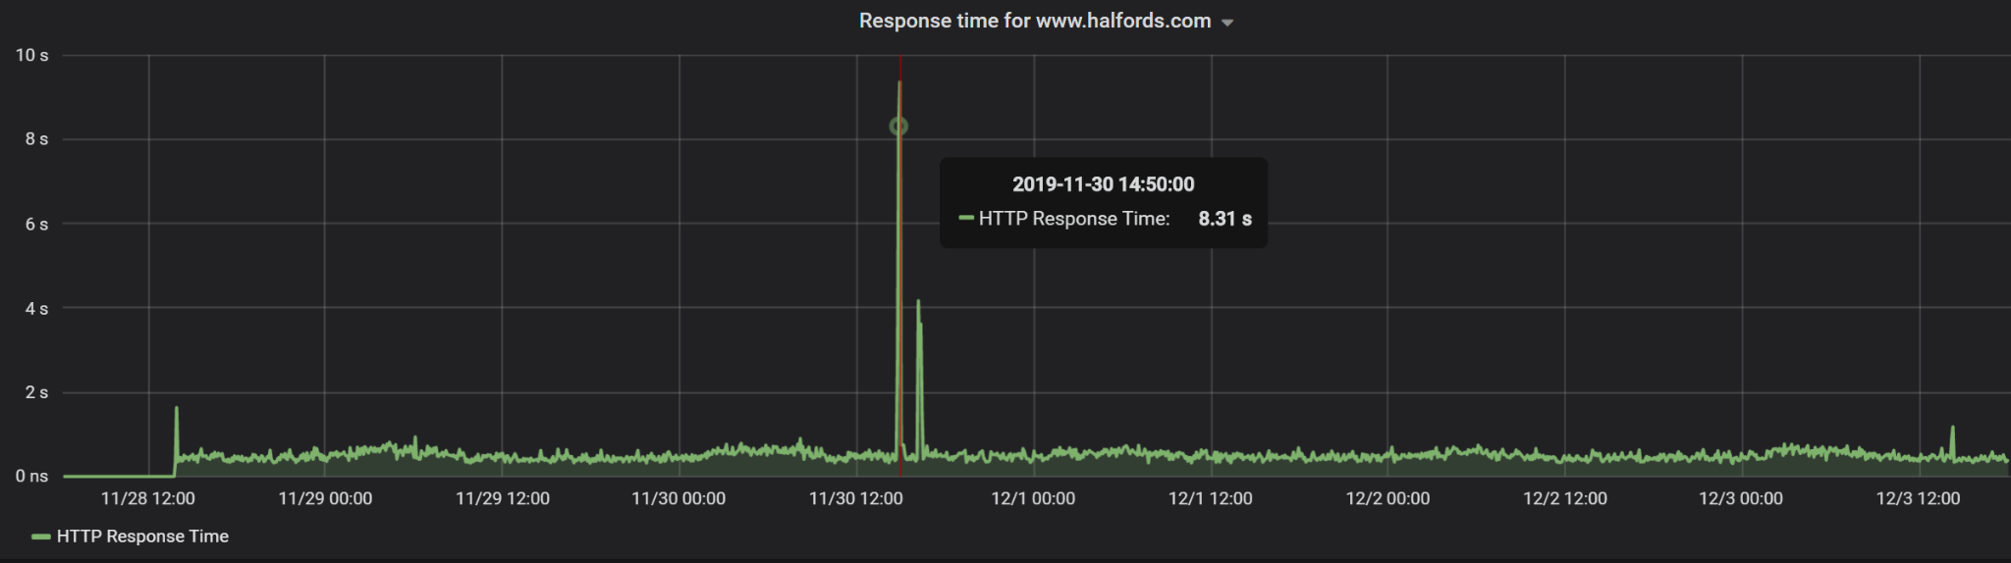
Spikes

Slide 10
Two kinds of spikes
Unplanned
Planned

Slide 11
Unplanned spikes
«Evening News»
«Go viral»
If the spike comes to quick you don’t have a chance to start servers… Though luck…
Once down; people hammer reload…

Slide 12
Planned spikes
Open the Gates – Black Friday
Gates get opened – Newsletters/Articles/Strategy

Slide 13
If you don’t…

Slide 14
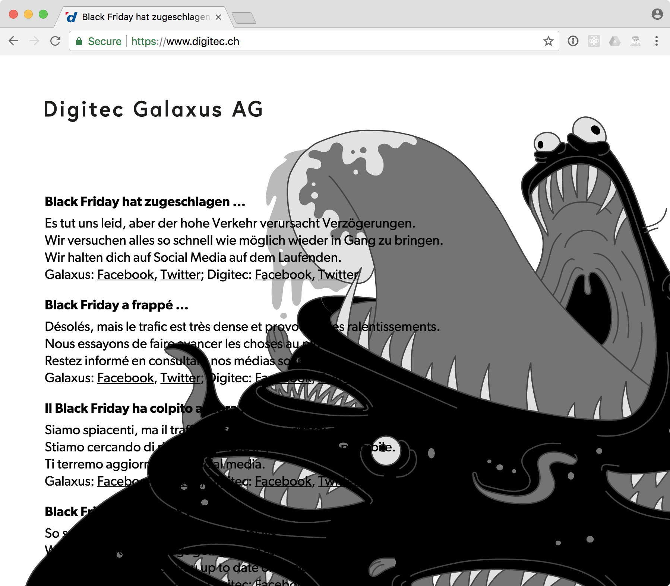
Black Friday
Digitec 2017

Slide 15
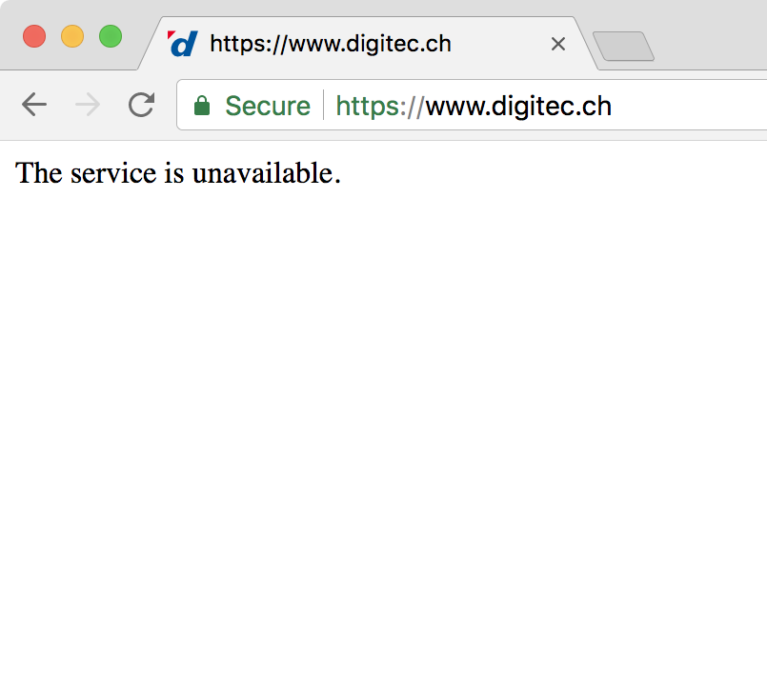
Black Friday
Digitec 2017

Slide 16
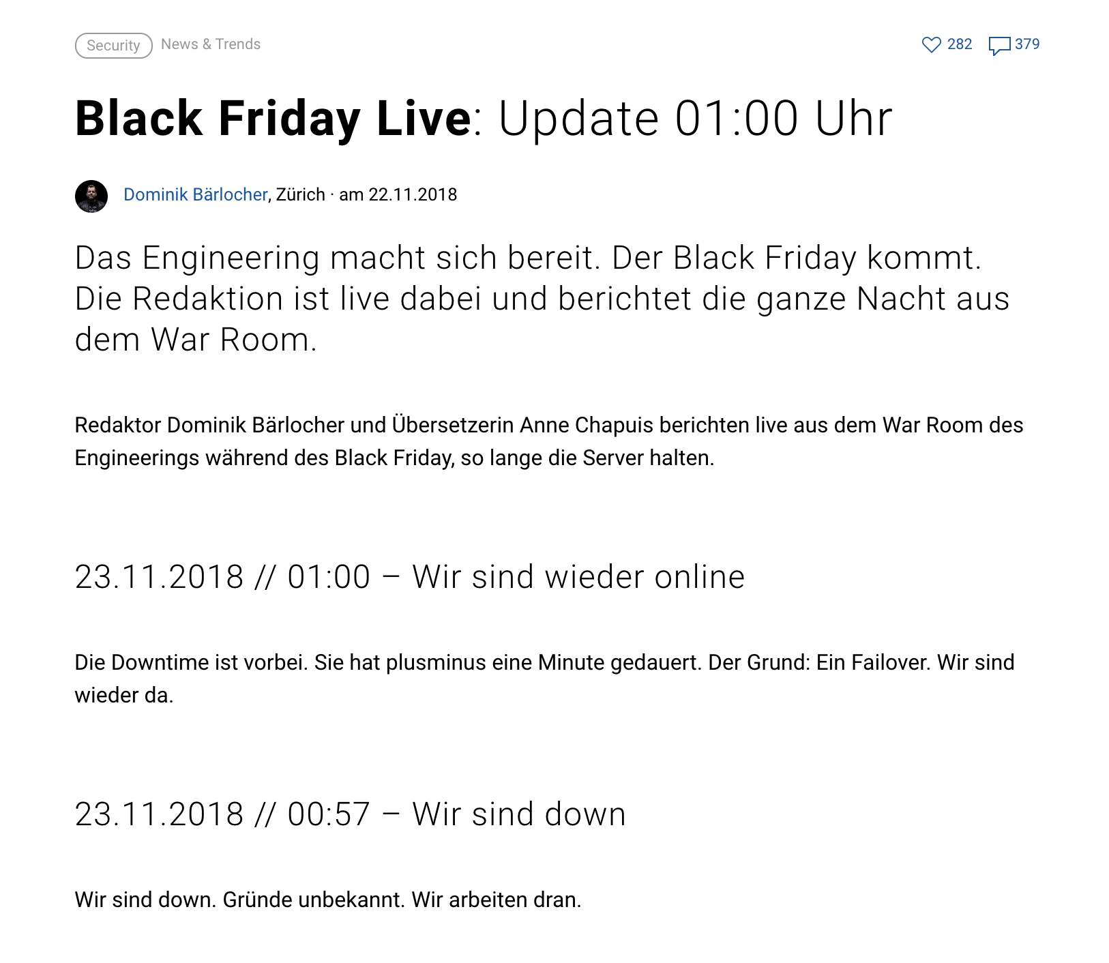
Black Friday
Digitec 2018

Slide 17
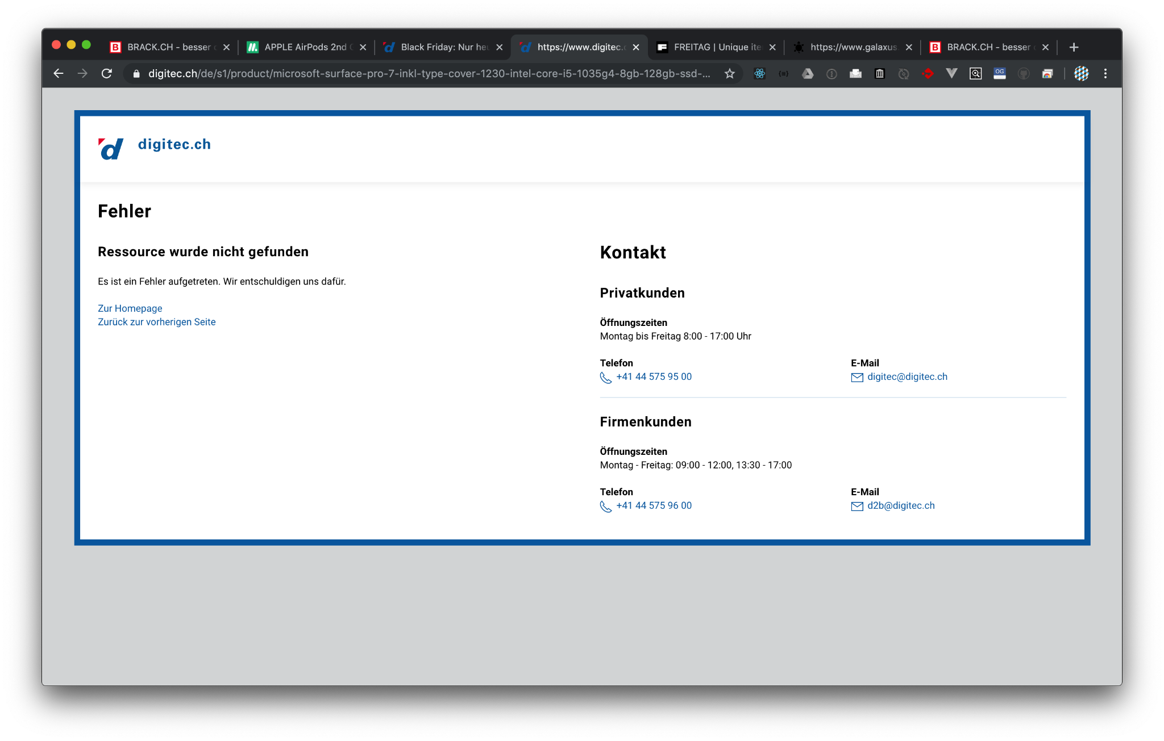
Black Friday
Digitec 2019

Slide 18
Black Friday
Digitec 2020 stays online

Slide 19

Spikes – not only your system
Microspot 2017

Slide 20
What’s the problem with traffic?

Slide 21
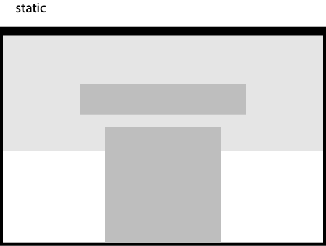
«Cheap» traffic

Slide 22
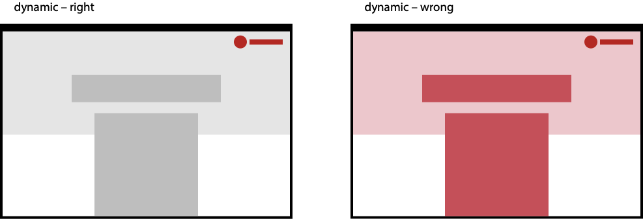
«Expensive» traffic

Slide 23
Who generates traffic?

Slide 24
It’s not only users...
Users
Rotbots/Scraper
API

Slide 25
«Strategies» to avoid expensive traffic

Slide 26
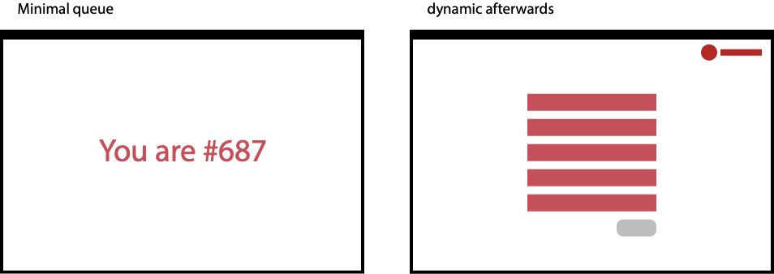
Gates

Slide 27
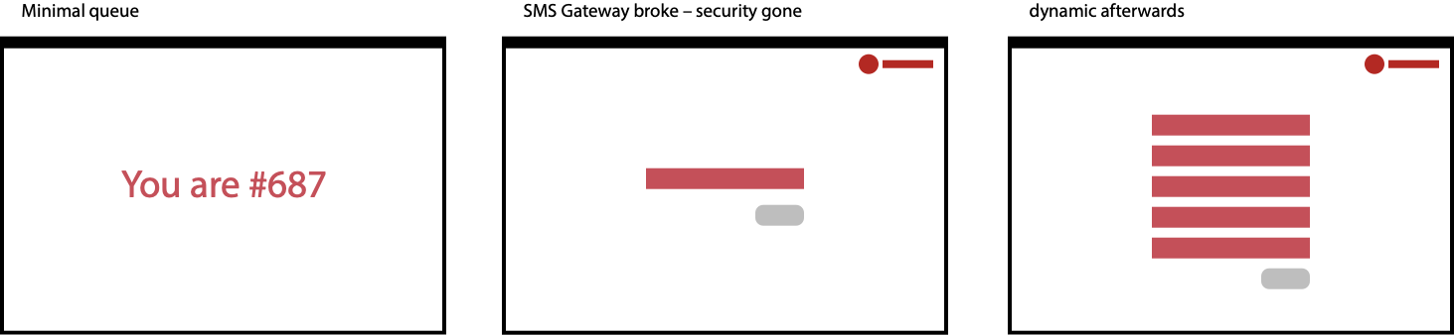
F###-up in Zurich

Slide 28
When is it gone?

Slide 29
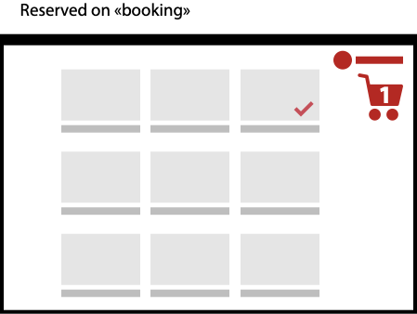
You will be «sold out» soon...

Slide 30
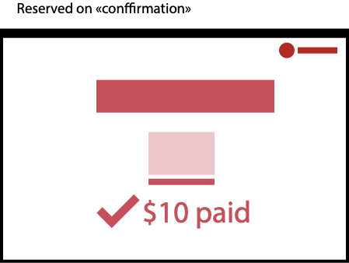
You have to chancel orders...

Slide 31
What is fair?

Slide 32
First come – first serve?
We live in a global world and people sleep
Some people work with hands
People usually don’t wait for your drop

Slide 33
What’s the solution?

Slide 34
I don’t know…

Slide 35
Technical excellence
Avoid dynamic content
Cache cache cache…

Slide 36
Strategies to avoid spikes

Slide 37
Simple tricks
Start your servers early
Newsletter spread over time
Know your clients and products
Freitag doesn’t sell black bags in the online-store. Causes too much traffic/request.

Slide 38
Other tricks
Lottery – it’s «fair» for everyone (register at any time) → you will get robots…
Automate waiting lists!
Voucher systems (other sellers?)
Example: People who got in get a voucher and can invite other people (chain of trust) – Fair?

Slide 39
Look forward to better solutions.
Thank you

